Slide 1
Predictions on Reddit Posts
David Berol
June 4, 2018

Slide 2
Questions Presented
What characteristics of a post on Reddit are most predictive of the overall interaction on a thread (as measured by number of comments)?
What vocabulary is most telling for discriminating between a pro-choice and a pro-life posting?

Slide 3
Questions Presented
What characteristics of a post on Reddit are most predictive of the overall interaction on a thread (as measured by number of comments)?
What vocabulary is most telling for discriminating between a pro-choice and a pro-life posting?

Slide 4
Methodology:
Sampled blocks of submissions, evenly distributed over the past 1.5 years
What characteristics of a post on Reddit are most predictive of the overall interaction on a thread (as measured by number of comments)?

Slide 5
Methodology:
Sampled blocks of submissions, evenly distributed over the past 1.5 years
Drew from all subreddits
What characteristics of a post on Reddit are most predictive of the overall interaction on a thread (as measured by number of comments)?

Slide 6
Methodology:
Sampled blocks of submissions, evenly distributed over the past 1.5 years
Drew from all subreddits
Filtered for submissions that received at least 100 comments.
What characteristics of a post on Reddit are most predictive of the overall interaction on a thread (as measured by number of comments)?

Slide 7
Methodology:
Sampled blocks of submissions, evenly distributed over the past 1.5 years
Drew from all subreddits
Filtered for submissions that received at least 100 comments.
Median # of comments = 169
What characteristics of a post on Reddit are most predictive of the overall interaction on a thread (as measured by number of comments)?

Slide 8
Methodology:
Sampled blocks of submissions, evenly distributed over the past 1.5 years
Drew from all subreddits
Filtered for submissions that received at least 100 comments.
Median # of comments = 169
Tagged submissions based on whether they received 169 or more comments (less interesting/more interesting)
What characteristics of a post on Reddit are most predictive of the overall interaction on a thread (as measured by number of comments)?

Slide 9
Methodology:
Sampled blocks of submissions, evenly distributed over the past 1.5 years
Drew from all subreddits
Filtered for submissions that received at least 100 comments.
Median # of comments = 169
Tagged submissions based on whether they received 169 or more comments (less interesting/more interesting)
~ 7,000 records
What characteristics of a post on Reddit are most predictive of the overall interaction on a thread (as measured by number of comments)?

Slide 10
Modeling:
Prediction Task: Does the post have >= 169 comments?
Predictor 1: Words/phrases in title
Predictor 2: Time since submission
Predictor 3: Subreddit
Predictor 4: Length of title
Predictor 5: A question mark
Predictor 6: An exclamation mark
What characteristics of a post on Reddit are most predictive of the overall interaction on a thread (as measured by number of comments)?

Slide 11
Modeling:
Prediction Task: Does the post have >= 169 comments?
Baseline Accuracy = 50% (just guess from evenly divided populations)
Model 1: Logistic Regression
(Test Accuracy = 59%)
Model 2: Random Forest
(Test Accuracy = 56% )
Model 3: Naive Bayes
(Test Accuracy = 56%)
What characteristics of a post on Reddit are most predictive of the overall interaction on a thread (as measured by number of comments)?

Slide 12
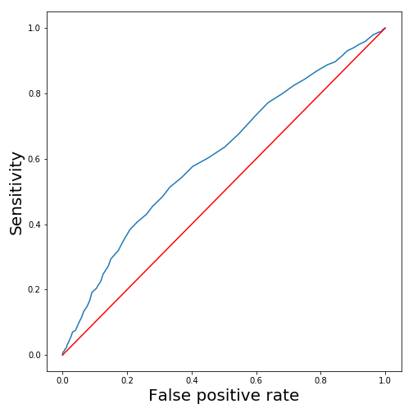
Modeling:
Logistic Regression
What characteristics of a post on Reddit are most predictive of the overall interaction on a thread (as measured by number of comments)?

Slide 13
Model Interpretation:
Predictor 1: Words/phrases in title
Predictor 2: Time since submission
Predictor 3: Subreddit
Predictor 4: Length of title
Predictor 5: A question mark
Predictor 6: An exclamation mark
What characteristics of a post on Reddit are most predictive of the overall interaction on a thread (as measured by number of comments)?

Slide 14
Model Interpretation:
Predictor 1: Words/phrases in title
Predictor 2: Time since submission
Predictor 3: Subreddit
Predictor 4: Length of title
Predictor 5: A question mark
Predictor 6: An exclamation mark
Predictor 2 coefficient nearly 0
What characteristics of a post on Reddit are most predictive of the overall interaction on a thread (as measured by number of comments)?

Slide 15
Model Interpretation:
Predictor 1: Words/phrases in title
Predictor 2: Time since submission
Predictor 3: Subreddit
Predictor 4: Length of title
Predictor 5: A question mark
Predictor 6: An exclamation mark
Predictors 4 and 6 were not statistically significant, at an alpha of .05
What characteristics of a post on Reddit are most predictive of the overall interaction on a thread (as measured by number of comments)?

Slide 16
Model Interpretation:
Predictor 1: Words/phrases in title
Predictor 2: Time since submission
Predictor 3: Subreddit
Predictor 4: Length of title
Predictor 5: A question mark
Predictor 6: An exclamation mark
Asking a question had a statistically significant (alpha of .05) negative impact on comment response.
Questions are 7% as likely to be in the high-comment class.
What characteristics of a post on Reddit are most predictive of the overall interaction on a thread (as measured by number of comments)?

Slide 17
Model Interpretation:
Predictor 1: Words/phrases in title
Predictor 2: Time since submission
Predictor 3: Subreddit
Predictor 4: Length of title
Predictor 5: A question mark
Predictor 6: An exclamation mark
Subreddits had larger impacts on likelihood of being in the high comment class; actual words used in title had lesser impacts
What characteristics of a post on Reddit are most predictive of the overall interaction on a thread (as measured by number of comments)?

Slide 18
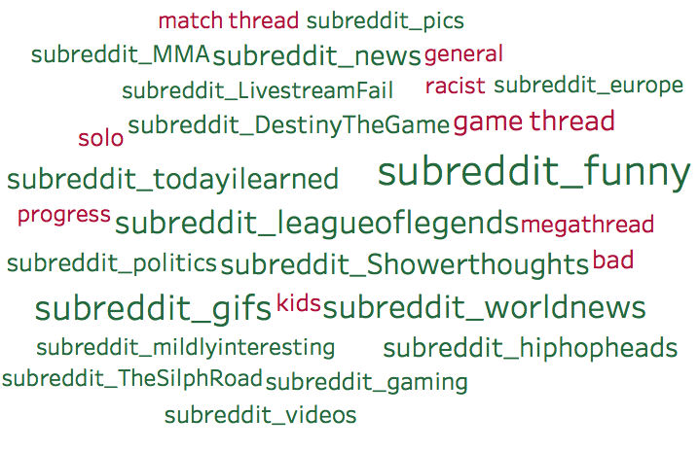

Slide 19
Questions Presented
What characteristics of a post on Reddit are most predictive of the overall interaction on a thread (as measured by number of comments)?
What vocabulary is most telling for discriminating between a pro-choice and a pro-life posting?

Slide 20
Methodology:
Sampled blocks of submissions and comments, evenly distributed over the past 1.5 years
Drew from r/prochoice and r/prolife
Tagged text based on source subreddit
~ 10,000 records
What vocabulary is most telling for discriminating between a pro-choice and a pro-life posting?

Slide 21
Modeling:
Prediction Task: Does the text come from the prolife subreddit?
Predictor: Words in the text
Baseline Accuracy = 50.8% (guess that all texts are pro-life)
Model: Naive Bayes
(Test Accuracy = 69.5%)
What vocabulary is most telling for discriminating between a pro-choice and a pro-life posting?

Slide 22
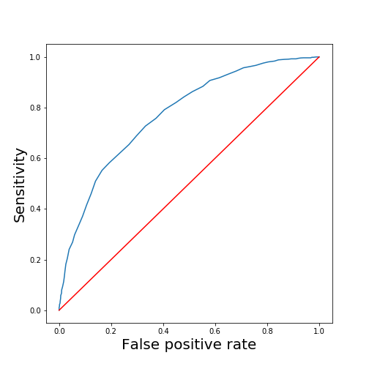
Modeling:
Naive
Bayes
What vocabulary is most telling for discriminating between a pro-choice and a pro-life posting?

Slide 23
Model Interpretation:
Naive Bayes Model works by observing the conditional probabilities of certain words:
Observe:
The probability of finding “Token X” given that we are in a document of Class 1
Calculate:
The probability of being in a document of Class 1, given that we have found “Token X”
What characteristics of a post on Reddit are most predictive of the overall interaction on a thread (as measured by number of comments)?

Slide 24
Model Interpretation:
We can get some insight into the classification model by considering (after setting aside commonplace words):
Which tokens have the highest conditional probability in a pro-life document?
Which tokens have the highest conditional probability in a pro-choice document?
Which tokens have the greatest inter-class disparity in conditional probability?
What characteristics of a post on Reddit are most predictive of the overall interaction on a thread (as measured by number of comments)?

Slide 25
“Most expected tokens” in a pro-choice document

Slide 26
“Most expected tokens” in a pro-life document

Slide 27
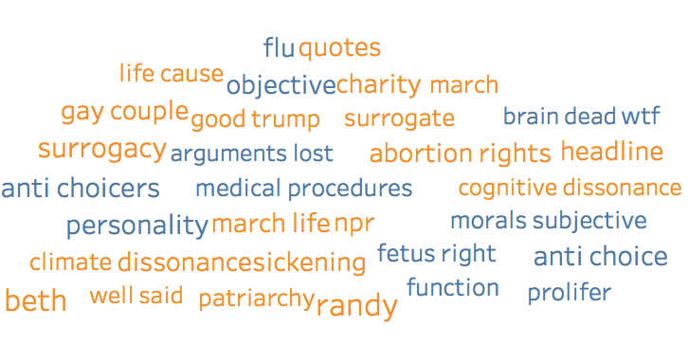

Most Probative Tokens

Slide 28
Future work:
Try additional models
Lemmatize/stem words
More feature engineering on text fields
Explore different slices of Reddit data
Questions?

